Slide 1
Project Presentation On “BLACK FRIDAY PREDICTION”
Presented By: Rahul M

Slide 2
Overview:
In this particular presentation we will be looking on:
How to analyze the dataset of BLACK FRIDAY PREDICTION.
What are the EDA steps in cleaning the dataset.
Overall analysis on the problem.

Slide 3
Problem Statement:
A retail company “ABC Private Limited” wants to understand the customer purchase behaviour (specifically, purchase amount) against various products of different categories. They have shared purchase summary of various customers for selected high volume products from last month. The data set also contains customer demographics (age, gender, marital status, city_type, stay_in_current_city), product details (product_id and product category) and Total purchase_amount from last month. Now, they want to build a model to predict the purchase amount of customer against various products which will help them to create personalized offer for customers against different products.

Slide 4
Exploratory Data Analysis:
I have imported required libraries and I have imported the dataset which was in excel format.
Then I did all the statistical analysis like checking shape, nunique, value counts, info etc…..
While checking for null values I found null values in the dataset and I replaced them using imputation technique.
I have also droped Unnamed:0 column as I found they are useless.
Next as a part of feature extraction I converted the data types of all the columns and I have extracted usefull information from the raw dataset. Thinking that this data will help us more than raw data.

Slide 5
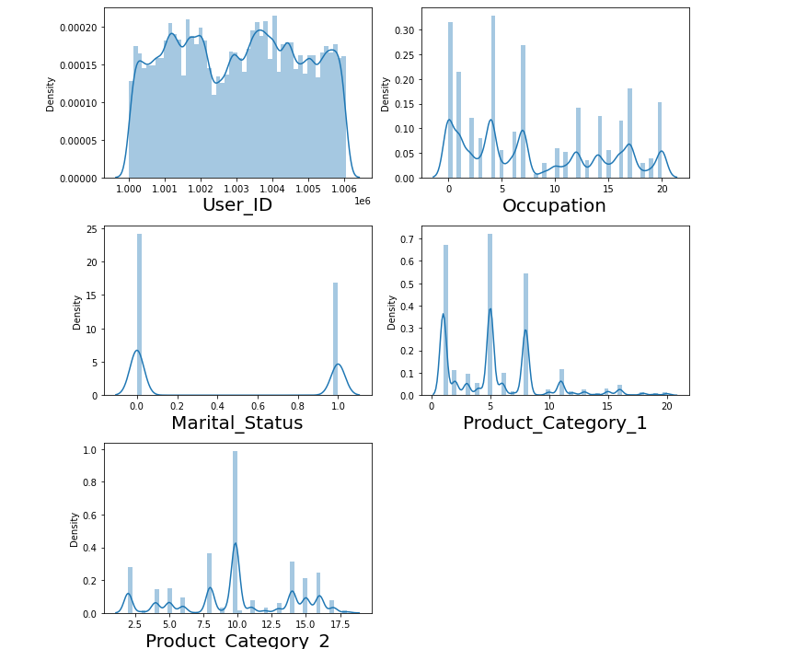
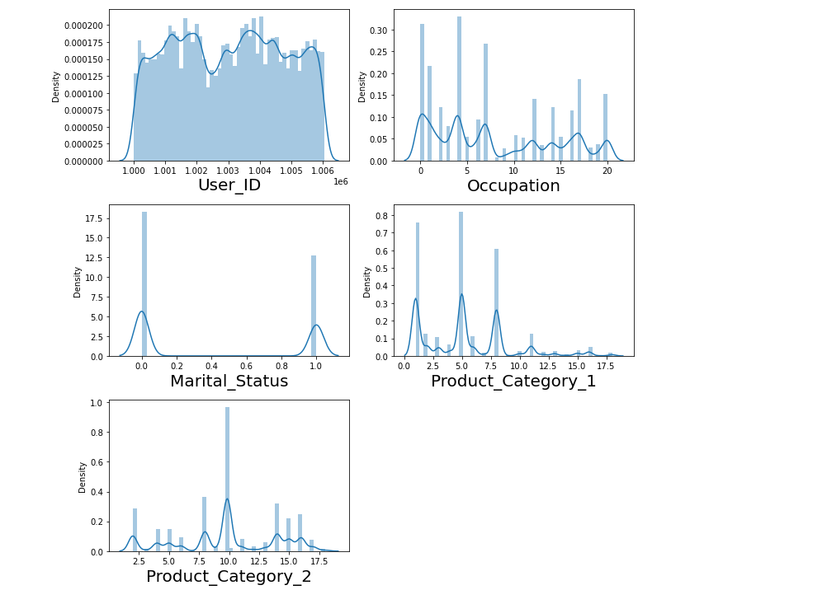
Univariate Visualization of numerical columns:
Testdata
Traindata
We can clearly see that there is skewness in most of the columns so we have to treat them using suitable methods

Slide 6
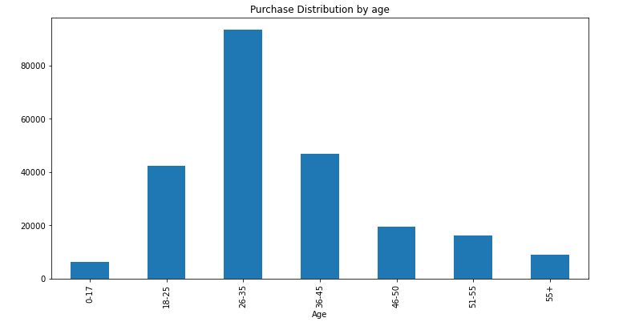
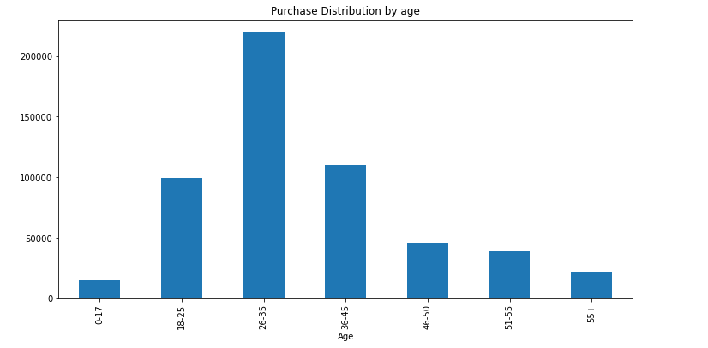
Univariate Vizualization of Categorical columns:
Traindata
Testdata
#We can see that in the 0-17 age group there are 6232 count
#We can see that in the 18-25 age group there are 42293 count
#We can see that in the 26-35 age group there are 93428 count
#We can see that in the 36-45 age group there are 46711 count
#We can see that in the 46-50 age group there are 19577 count
#We can see that in the 51-55 age group there are 16283 count
#We can see that in the 55+ age group there are 9075 count
#So max data is in 18-25 age group and least in 0-17 age group
#We can see that in the 0-17 age group there are 15102 count
#We can see that in the 18-25 age group there are 99660 count
#We can see that in the 26-35 age group there are 219587 count
#We can see that in the 36-45 age group there are 110013 count
#We can see that in the 46-50 age group there are 45701 count
#We can see that in the 51-55 age group there are 38501 count
#We can see that in the 55+ age group there are 21504 count
#So max data is in 18-25 age group and least in 0-17 age group in train dataset

Slide 7
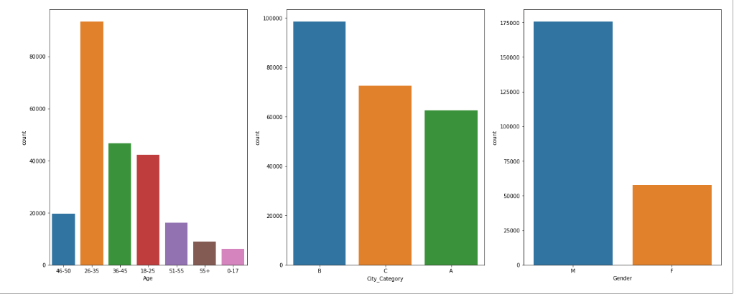
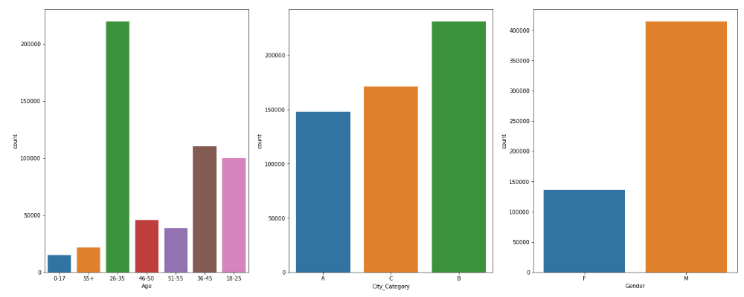
Univariate Vizualization of Categorical columns:
Traindata
Testdata
-the Highest data is in 26-35 in the traindataset
the least data is in 26-35 in the traindataset
-Among the city category B has the highest count and
-Least count in city category A
The male Count is the highest in dataset
- the Highest data is in 26-35 in the testdataset
- the least data is in 26-35 in the testdataset
- Among the city category B has the highest count and
- Least count in city category A
- The male Count is the highest in dataset

Slide 8
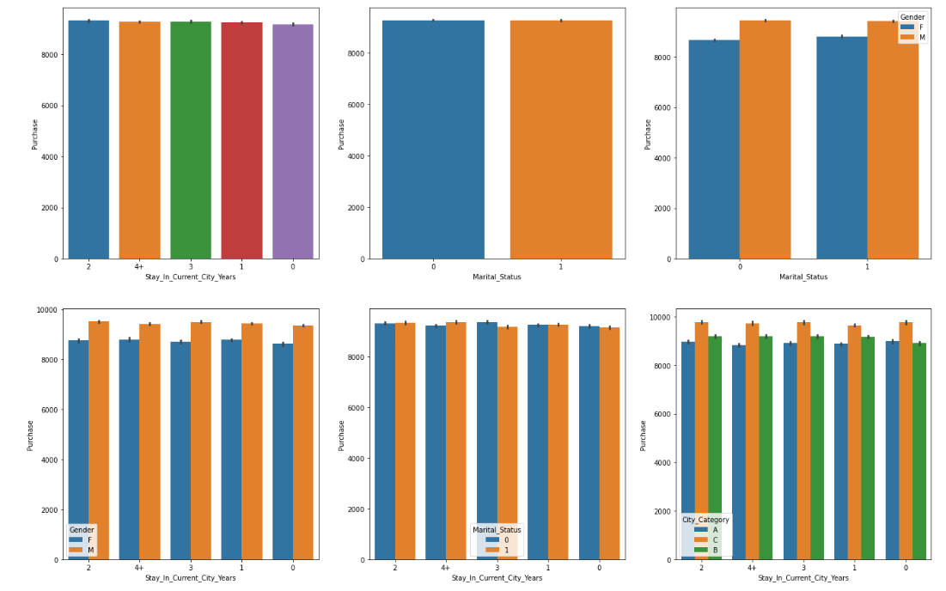
Bivariate Vizualization of Categorical columns:
- We can see Stay_In_Current_City_Years has the highest count in 1 year the train dataset
- and Stay_In_Current_City_Years is least count in less than 1 year the train dataset
- We can see the data with married people less in the dataset
- Among the datastet males are dominating in the married and nonmarried people in the dataset
- We can see least dataAmnong the females with in married people

Slide 9
Bivariate Vizualization of Categorical columns:
- We can see Stay_In_Current_City_Years has almost equal no of purchase count in the train dataset
- and Stay_In_Current_City_Years has the highest count for males in the train dataset
- Comparing the data difference of percentage of males and female is small among teh dataset
- We can see the data with married people having almost equal no of purchase count in the train dataset
- Among the datastet males are dominating in the married and nonmarried people in the dataset in Purchase counts
- We can see least dataAmnong the females with in married people with Purchase counts

Slide 10
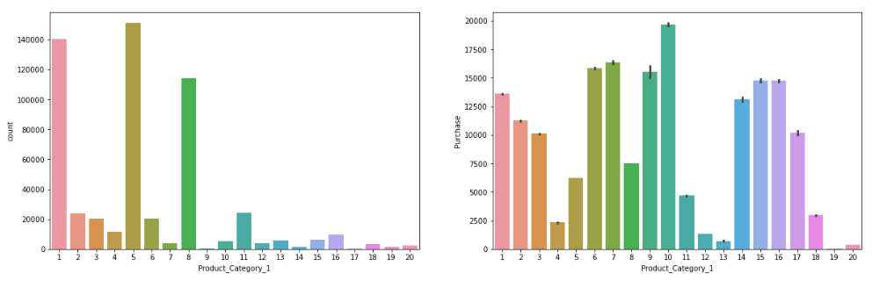
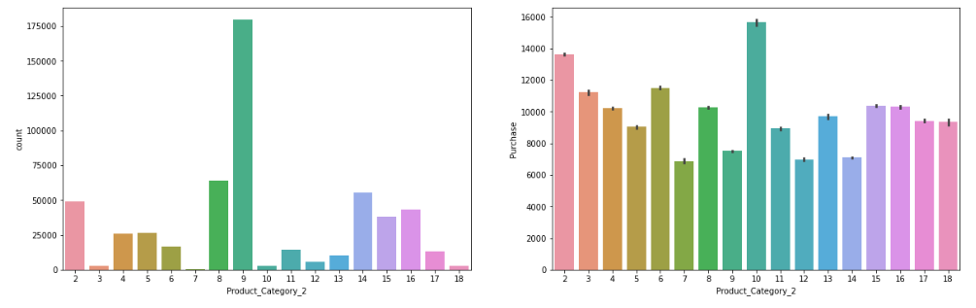
Univariate Vizualization of Categorical columns:
- In Product_Category_2 Category 9 has the highest count and least in Category 7.
- The second highest is in Category 8 and 14 in the train dataset
- the categories 9,8,2,14,15,16 has predominence in the train dataset
- The purchase count is highest for the category for 10 and
- least in categories 7,12,14 in the dataset
- In Product_Category_1 Category 5 has the highest count and least in Category 9 and 17.
- The second highest is in Category 1 in the train dataset
- the categories 1,5,8 has predominence in the train dataset
- The purchase count is highest for the category for 10 and
- least in categories 4 and 12,13,19,20 in the dataset

Slide 11
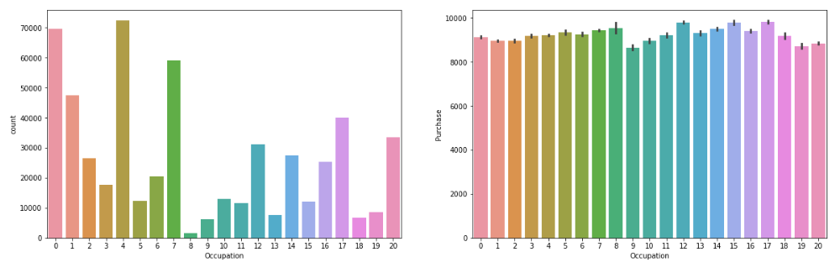
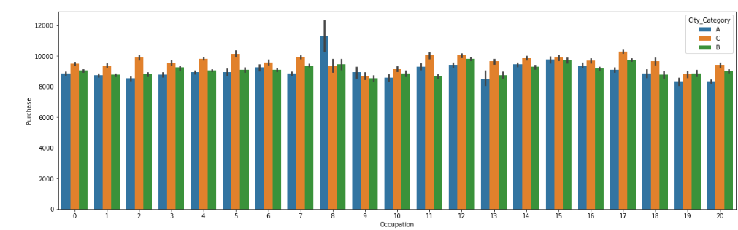
Univariate Vizualization of Categorical columns:
- In Occupation Category 4,0,7 have the highest counts and least in Category 8.
- The second highest is in Category 8 and 14 in the train dataset
- the categories 9,8,2,14,15,16 has predominence in the train dataset
- The purchase count have the highest counts for 12,15,17 Category and
- least in categories 9,19 in the dataset
- Among the Occupation categories we can see that except in category 8 all the occupation categories are having highest in City category of C in terms of purchase counts
- In almost all the occupation categories the City category A is least purchase counts

Slide 12
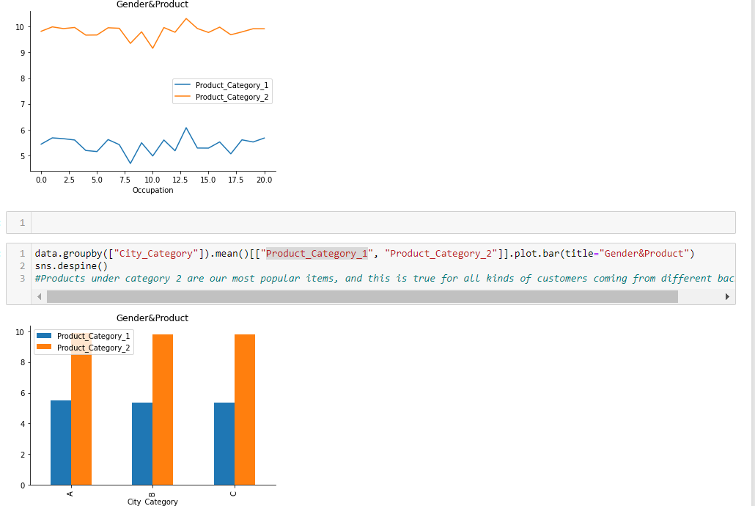
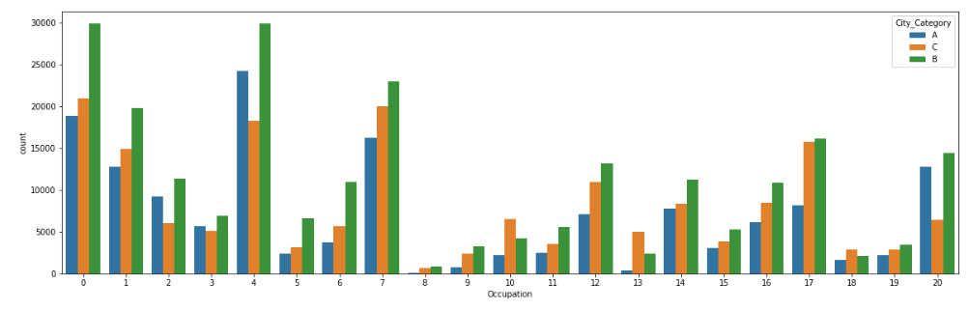
Checking for outliers
- Among the Occupation categories 0 ,4 7 has the highest percentage of data in the three city categories
- In almost all the occupation categories 8 8,18,19 are tyhe least counts with least data in the City category A

Slide 13
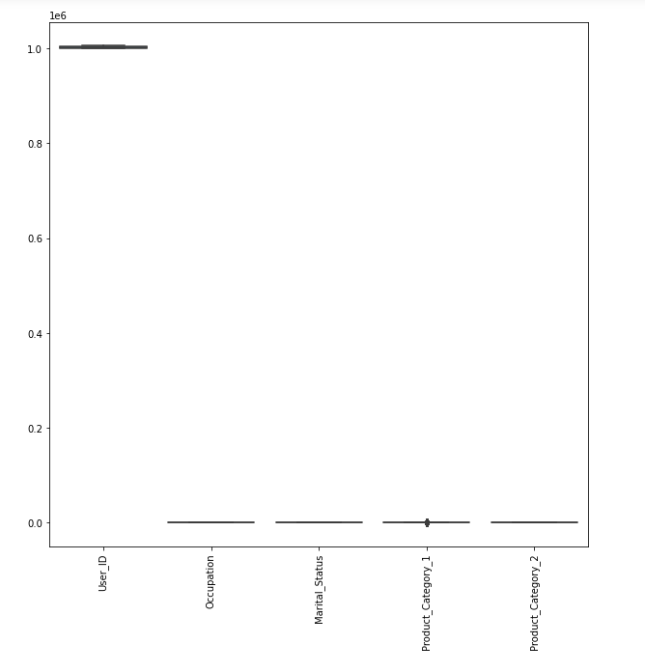
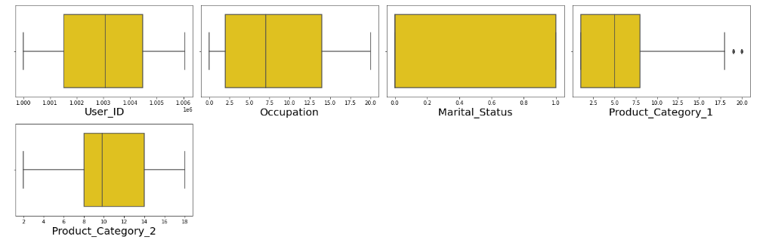
Univariate Vizualization of Categorical columns:
We can see some outier in Product category1 in the dataset in the dataset

Slide 14
Conclusion:
In this project report, we have used step by step procedure to analyze the dataset and finding the correlation between the features.
Thus we can select the features which are correlated to each other and are independent in nature. The power of visualization has helped us in understanding the data by graphical representation it has made me to understand what data is trying to say.
Data cleaning is one of the most important steps to remove unrealistic values and unnecessary values.
Future direction of research may consider incorporating additional purchase data from a larger economical background with more features.

Slide 15
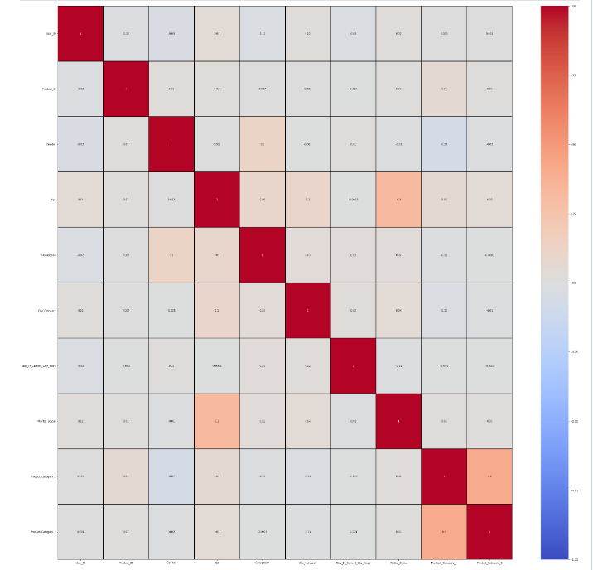
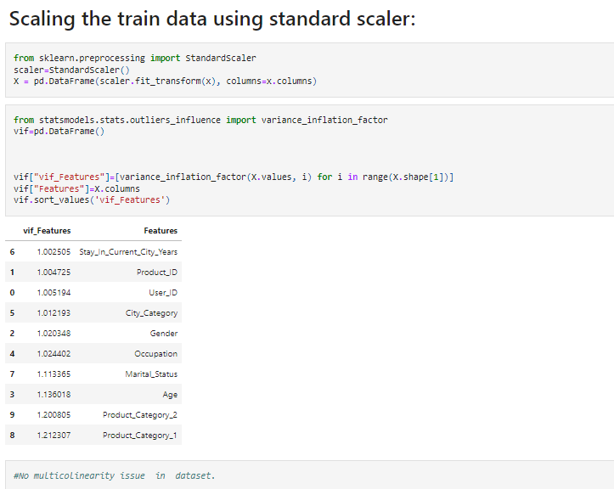
HeatMap

Slide 16
Analysis:
I have used dist plot to check the skewness in numerical columns.
I have used bar plot for each of categorical feature that shows the relation with the purchase for all the sub categories in each categorical feature.
And also for continuous numerical variables I have used line plot to show the relationship between continuous numerical variable and target variable.
I found that there is a linear relationship between features.

Slide 17
Data Cleaning Steps:
In my datasets I found null values, outliers and also skewness.
I have used imputation method to replace null values. To remove outliers I have used Z-score method. And to remove skewness I have used yeo-johnson method.
To encode the categorical columns I have use Label Encoding.
Use of Pearson’s correlation coefficient to check the correlation between dependent and independent features.
Also I have used standardization. Then followed by model building with all regression algorithms.

